Slide 1
Careers in Sport and Exercise Science
WWW.CAREERS-IN-SPORT.CO.UK
Professor Martin I. Jones
BSc PGCHE MSc PhD CPsychol CSci AFBPsS SFHEA

Slide 2
Science
Systematic study of the structure and behavior of sport and exercise through observation and experiment.
Human focussed with some focus on sports technologies
What is sport and exercise science?
WWW.CAREERS-IN-SPORT.CO.UK

Slide 3
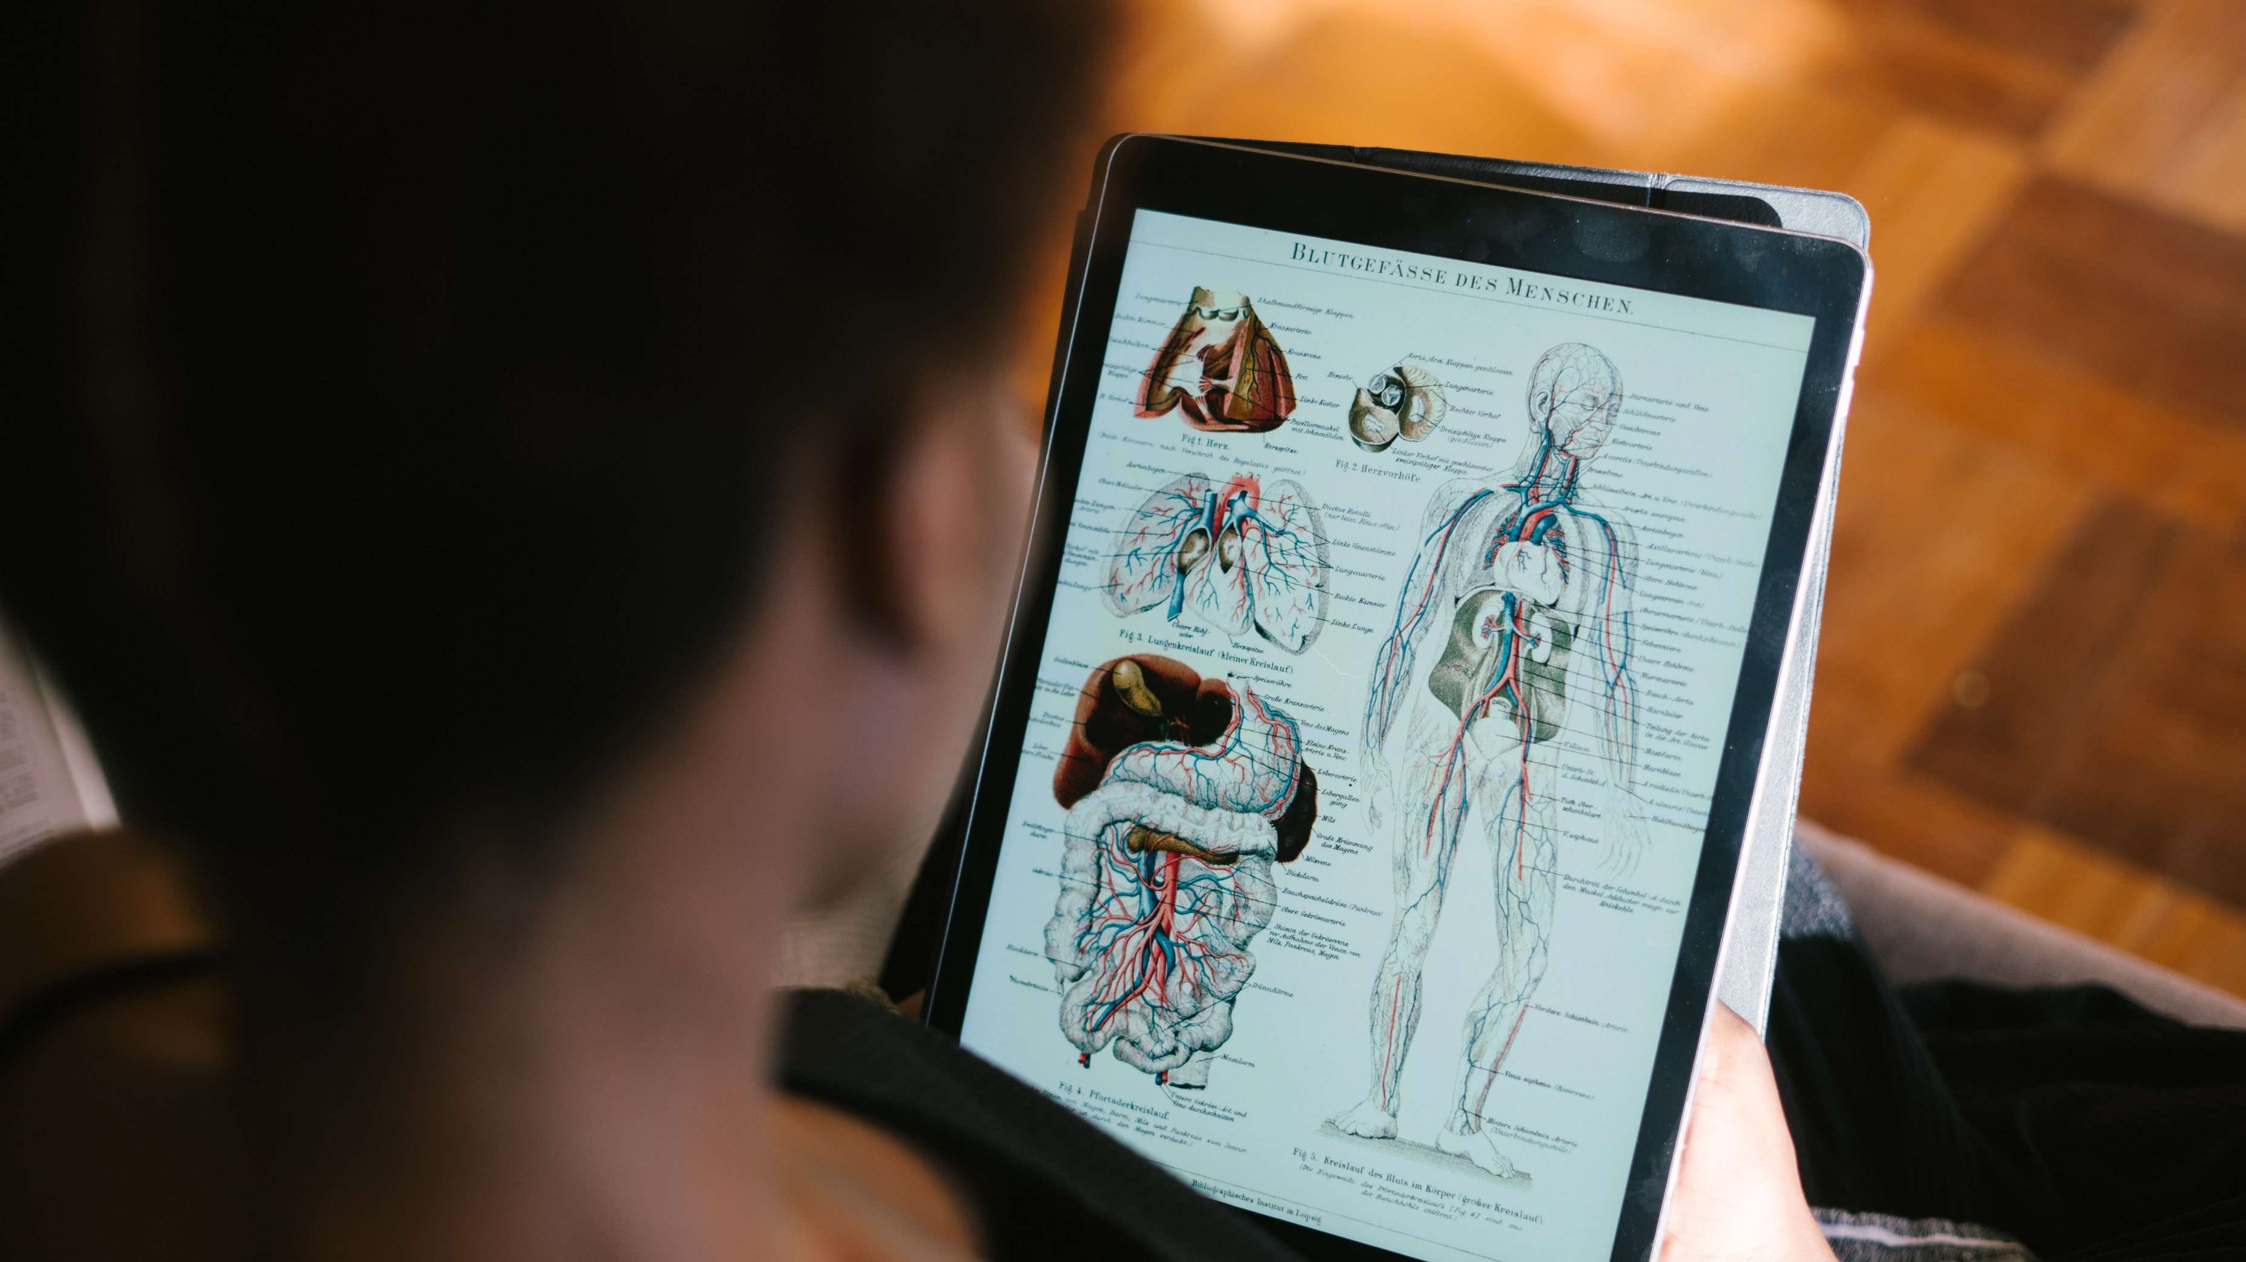
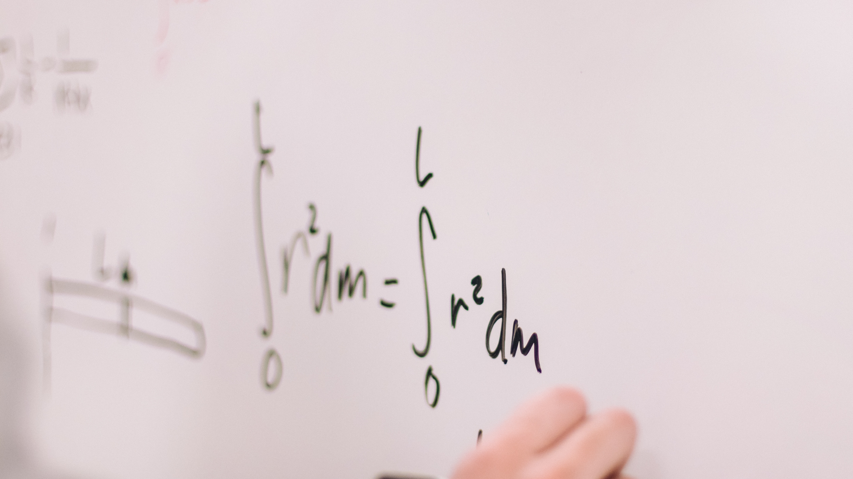
Sport and Exercise Sciences
Psychology
Physiology
Biomechanics
Understanding the thoughts, feelings, and behaviours that influence sport and exercise
Understanding how the body works
Understanding how the body moves

Slide 4
Constituent sciences
Psychology
Physiology
Biomechanics
Sociologist
Public health
Exercise referral
Sleep science
Neuroscience
“Omics”
Nutrition
Data analytics
WWW.CAREERS-IN-SPORT.CO.UK

Slide 5
Sport
Exercise
Human performance focused
Health and well being of athletes
Private and public sector
Example job:
Physiologist to a professional cycling team
Human health focused
Health and well being of general public
Public and private sector
Example Job:
Cardiac rehabilitation specialist in a hospital or outpatient setting
WWW.CAREERS-IN-SPORT.CO.UK

Slide 6
A third space?
Business
Use sport and exercise science skills to support elite performers in other sectors
WWW.CAREERS-IN-SPORT.CO.UK

Slide 7
Multi-disciplinary
Sport and Exercise science can provide a steppingstone for other professions.
For example, sport scientists specialise and become physiotherapists, sports doctors, military officers, or psychologists.

Slide 8
Teamwork
Leadership
Collaboration
Negotiation
Enthusiasm
Attention to detail
Prioritisation
Working to deadlines
Analytics and problem solving
Critical thinking
Planning
Coordinating
Systems thinking
Dealing with pressure
Communication
Record keeping
Skills

Slide 9
Undergraduate (BSc)
Masters (MSc, MRes)
Doctoral degree (PhD, DPhil),
Professional training
Professional accreditation
Continual professional development
Qualifications

Slide 10
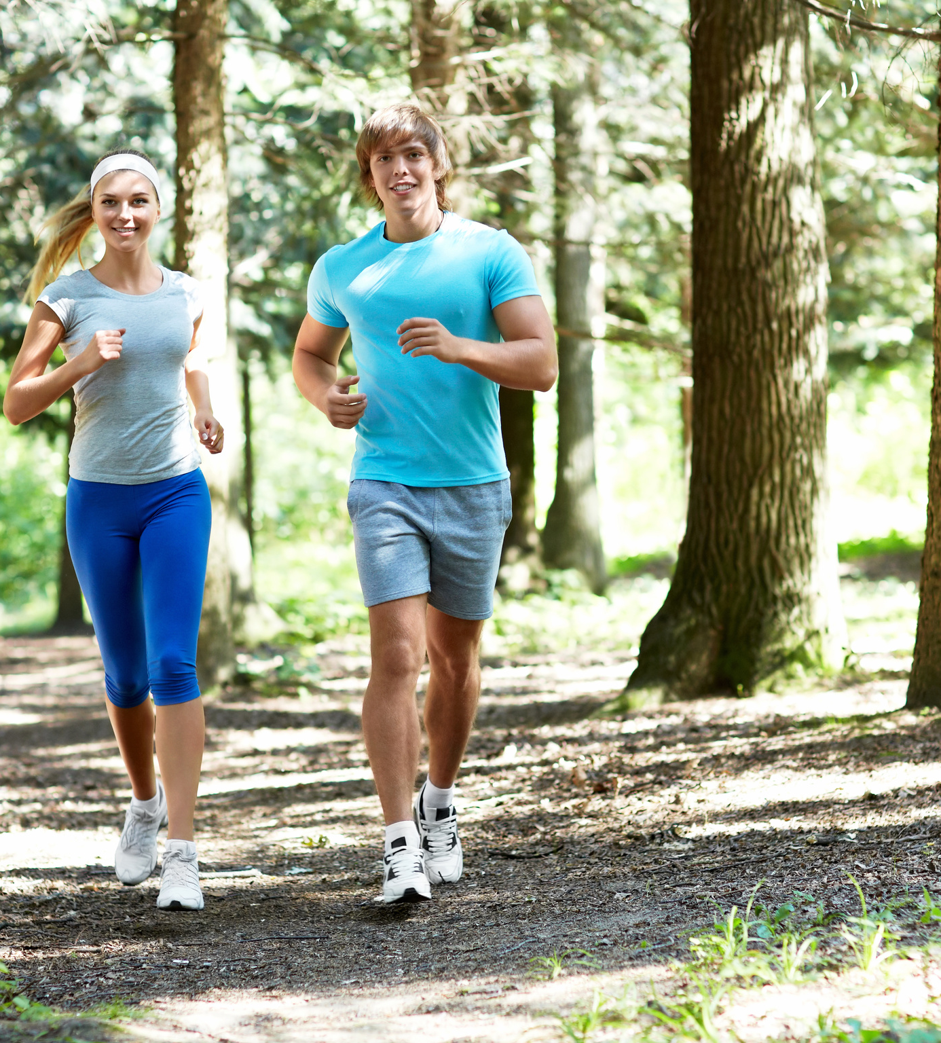
Ways of working
Professional organisations
Professional teams
Government departments
Schools
Sole trader / consultant
Working as your own boss
Consult with coaches, teams, athletes, parents
A mixture
Combine working for an organisation and working for yourself

Slide 11
The Future?
Where might sport and exercise go in the next 25 years?

Slide 12
www.careers-in-sport.co.uk
Thank You
Professor Martin I. Jones
BSc PGCHE MSc PhD CPsychol CSci AFBPsS SFHEA

